Slide 1
Chapter 1: Diodes and Applications
Module – 2 : Applications of Diodes
Reference: Robert L. Boylestad, Louis Nashelsky, Electronic Devices & Circuits Theory, 11th Edition, PHI, 2012

Slide 2
At the end of this module, students will be able to:
Explain need for AC to DC conversion
Discuss basic DC power supply unit.
Discuss and analyze the working of a various rectifier circuits.
Explain how capacitor filter can be used to minimize the ac component.

Slide 3
Topics
Introduction
Half wave rectifier
Full wave rectifier
Center tapped FWR
Full wave bridge rectifier
Rectifiers with capacitor filter

Slide 4
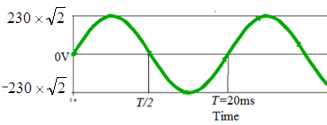

Introduction
AC and DC signal
$V_{in}\left(t\right)=V_{m}\sin\left(2πft\right)$
$V_{in}\left(t\right)=230\sqrt{2 }sin\left(2π50t\right)$
Electricity distribution in INDIA: AC signal of 230V, 50HZ.
AC signal with A=230V, f=50Hz

Slide 5
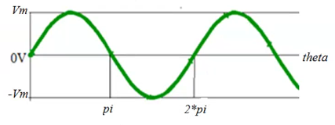
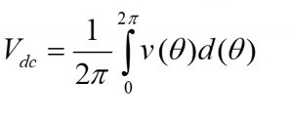
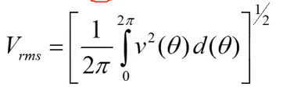

Introduction
AC Signal $V\left(θ\right)=V_{m}\sin{(θ)}$
Define
Average/DC/mean value
RMS of effective value

Slide 6

Introduction
Calculate the DC and RMS value of the signal
$$V\left(θ\right)=V_{m}\sin{(θ)}$$

Slide 7
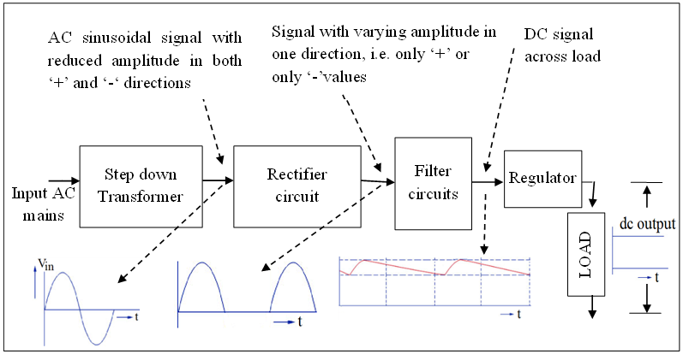
Block diagram of a DC power supply

Slide 8
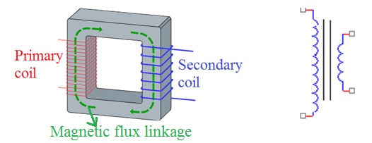
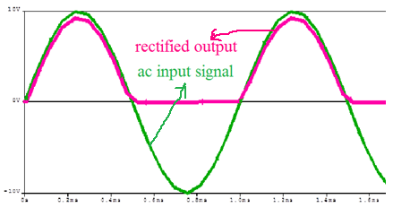
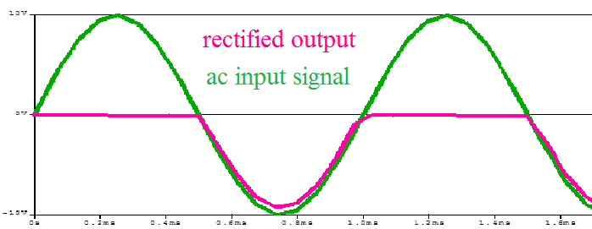
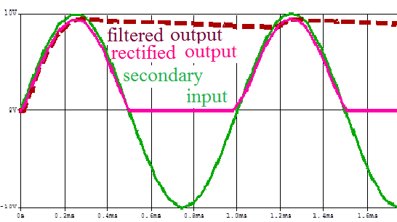
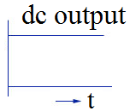
Steps of conversion
Step down transformer
Rectified output w.r.t. transformer output
Filtered output
Regulator output (Pure DC)
Notes:
A step down transformer reduces the voltage of an ac signal is called a step down transformer.
Rectifiers converts an ac sinusoidal signal that is bidirectional with positive and negative amplitudes into a signal with only unidirectional amplitudes that is only positive or only negative. Thus rectifier circuit forces the current through the load to flow in only in one direction. The out put of rectifier is called pulsating dc signal.
A filter circuit filters ac content from pulsating dc. A filter has to have a capacitor, an energy storing component that can hold the voltage to the peak value of the rectified pulsating dc and then dissipate energy to load when the pulsating dc drops.
Finally regulator is used to provide constant dc voltage despite of variations in the mains ac power supply or load variations.

Slide 9
Rectifier
Converts AC to pulsating DC
Diode is the primary element
Half wave rectifier
Full wave rectifier
Centre tapped full wave rectifier
Full wave bridge rectifier

Slide 10
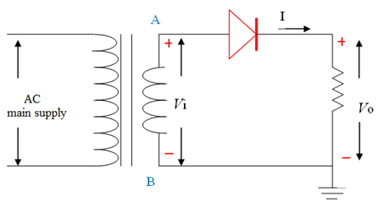
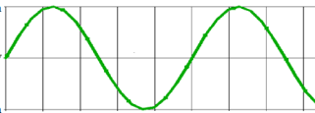

Half wave rectifier

Slide 11
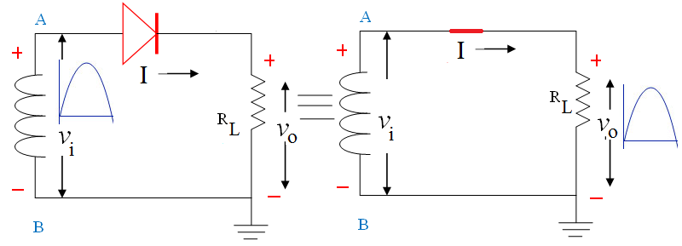
Working of HWR
Equivalent Circuit of HWR, when node A is positive w.r.t node B
Notes:
Fig 8: Voltage at node A is positive with respect to voltage at node B, forces the diode to be forward bias and act as a short. This results in current flow through the load resistance R_{L}. Hence output voltage is approximately equal to the secondary voltage.
fig. 9: during the negative half cycle, the voltage at node A is negative with respect to node B that forces the diode in reverse biased and act as open circuit. This results in no current flow through the load

Slide 12
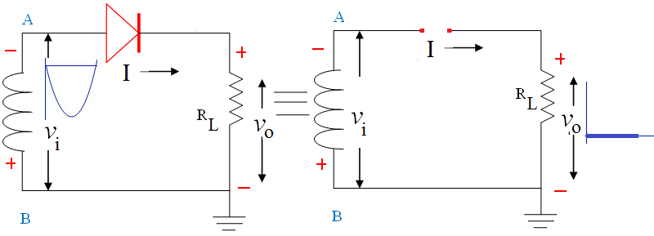
Working of HWR
Equivalent Circuit of HWR, when node A is negative w.r.t node B

Slide 13
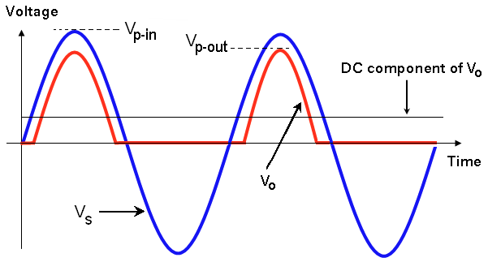
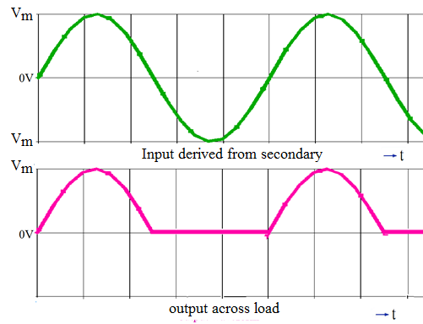
HWR Waveforms
Ideal Diode
Practical Diode

Slide 14
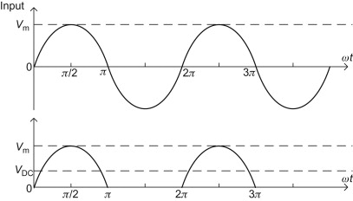
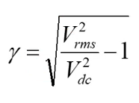
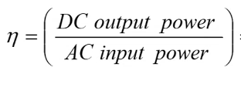
Performance parameters of HWR
DC/average output voltage
Ripple factor
Efficiency
Peak inverse voltage(PIV)

Slide 15


Performance parameters of HWR
$I_{m}$=$\frac{V_{m}−V_{ϒ}}{R_{L}+R_{F}}$ ≃ $\frac{V_{m}}{R_{L}}$
$$I=\left\{\begin{aligned}I_{m}\sin\left(θ\right), 0≤θ≤π \\ \text{0 }, π≤θ≤2π\end{aligned}\right.$$

Slide 16

Average/DC value of load current ($I_{dc}$)
$I_{dc}$=$\frac{1}{2π}\int_{0}^{2π}{I_{L}}$d$θ$
= $\frac{1}{2π}\int_{0}^{π}{I_{m}}$sin ($θ$) d$θ$
= $\frac{−I_{m}}{2π}$ ${\left[cos⁡(θ)\right]}_{0}^{π}$
$I_{dc}$= $\frac{I_{m}}{π}$

Slide 17

Average/DC voltage across the load ($V_{dc}$)
$V_{dc}$= $I_{dc}$* $R_{L}$
= $\frac{I_{m}}{π}$ * $R_{L}$
= $\frac{V_{m}}{R_{L}∗π}$ * $R_{L}$
$V_{dc}$ = $\frac{V_{m}}{π}$

Slide 18
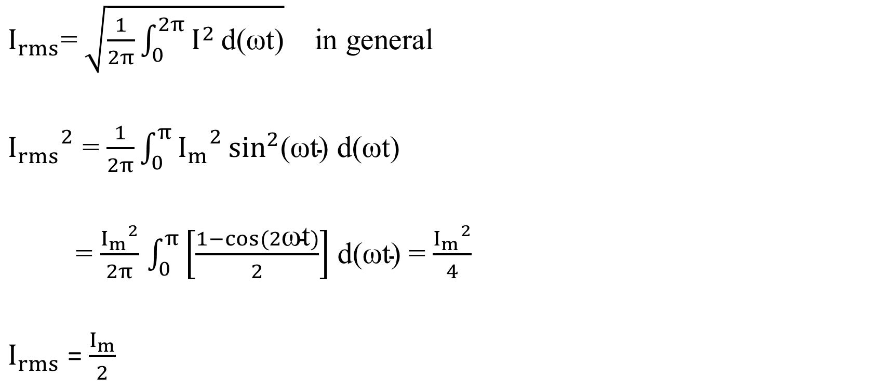
RMS value of load current ($I_{rms}$)
$I_{rms}$=$\sqrt{\frac{1}{2π}\int_{0}^{2π}{I^{2}}\text{d}\text{(}\text{ω}\text{t}\text{)}}$ in general
${I_{rms}}^{2}$ = $\frac{1}{2π}\int_{0}^{π}{{I_{m}}^{2}}\sin^{2}\text{(}\text{ω}\text{t}\text{) }\text{d}\text{(}\text{ω}\text{t}\text{)}$
= $\frac{{I_{m}}^{2}}{2π}$ $\int_{0}^{π}{\left[\frac{1−cos(2\text{ω}\text{t})}{2}\right]}$ $\text{d}\text{(}\text{ω}\text{t}\text{)}$ = $\frac{{I_{m}}^{2}}{4}$
$I_{rms}$ =$\frac{I_{m}}{2}$

Slide 19


RMS value of the load voltage ($V_{rms}$)
$V_{rms}$= $I_{rms}$* $R_{L}$
= $\frac{I_{m}}{2}$ * $R_{L}$
= $\frac{V_{m}}{R_{L}∗2}$ * $R_{L}$
$V_{rms}$ = $\frac{V_{m}}{2}$

Slide 20
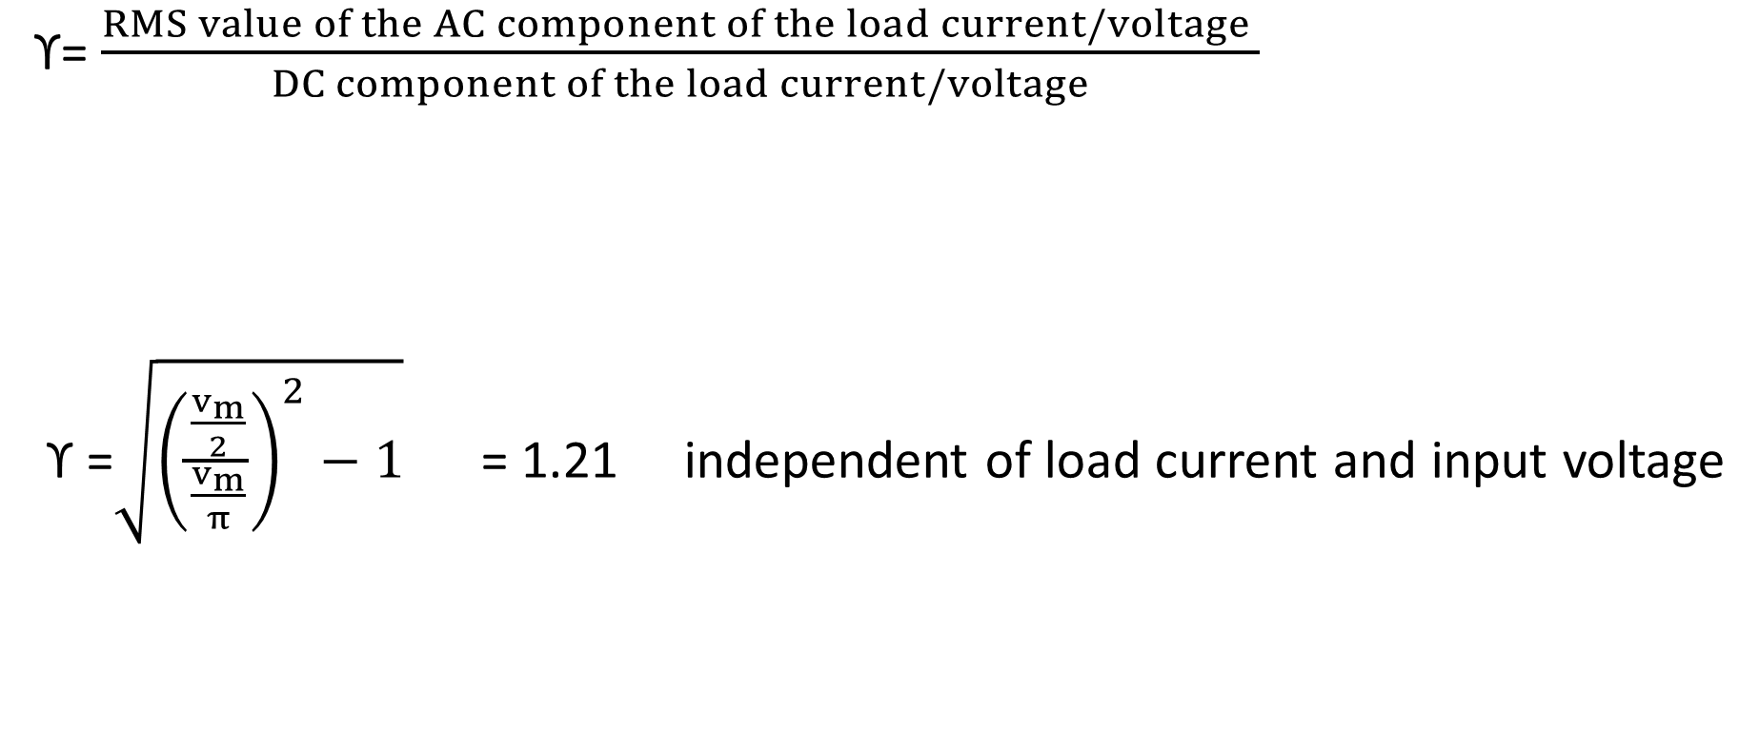
Ripple factor (ϒ)
ϒ= $\frac{RMS value of the AC component of the load current/voltage }{DC component of the load current/voltage}$
ϒ =$\sqrt{{\left(\frac{\frac{v_{m}}{2}}{\frac{v_{m}}{π}}\right)}^{2}−1}$ = 1.21 independent of load current and input voltage

Slide 21
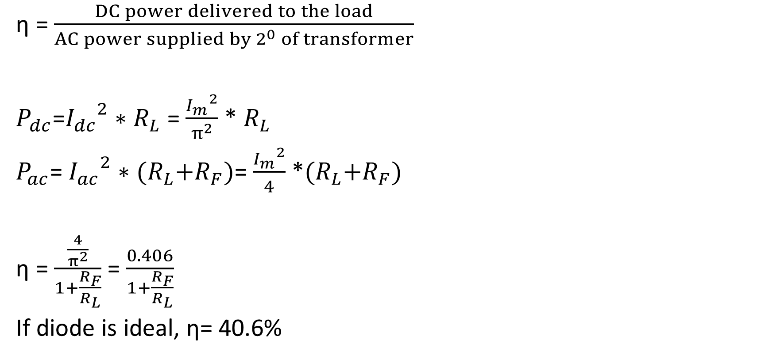
Efficiency (η)
η = $\frac{DC power delivered to the load}{AC power supplied by 2^{0} of transformer}$
$P_{dc}$=${I_{dc}}^{2}∗$ $R_{L}$ = $\frac{{I_{m}}^{2}}{π^{2}}$ * $R_{L}$
$P_{ac}$= ${I_{ac}}^{2}∗$ ${(R}_{L}+R_{F})$= $\frac{{I_{m}}^{2}}{4}$ *${(R}_{L}+R_{F})$
η = $\frac{\frac{4}{π^{2}}}{1+\frac{R_{F}}{R_{L}}}$ = $\frac{0.406}{1+\frac{R_{F}}{R_{L}}}$
If diode is ideal, η= 40.6%

Slide 22
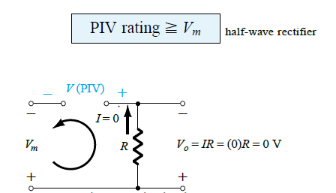
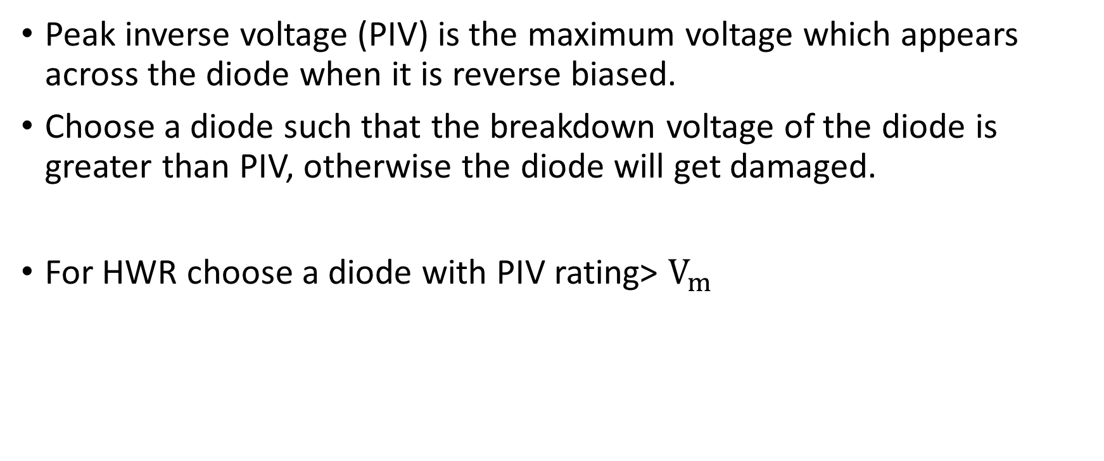
Peak Inverse Voltage(PIV)
Peak inverse voltage (PIV) is the maximum voltage which appears across the diode when it is reverse biased.
Choose a diode such that the breakdown voltage of the diode is greater than PIV, otherwise the diode will get damaged.
For HWR choose a diode with PIV rating> $V_{m}$

Slide 23
Topics covered in last class
Need of AC to DC conversion
Block diagram of DC power supply unit
Introduction to Rectifiers
Working of half wave rectifier
Performance analysis of half wave rectifier

Slide 24
Numerical Problems
Q1. A voltage v = 100 Sin ωt and frequency 50 Hz is applied to half wave rectifier. If the load resistance is 2KΩ , calculate:
Peak value of load current
Average load current
Rms or effective load current
Average output voltage, Rms output voltage
AC input power, DC output power
Efficiency
Ripple factor
Ans: Vm=100V, (a) 50mA, (b)15.9mA, (c) 25mA (d) 31.8V , 50V (e) 1.25W, 0.50562W (f) 0.404 (g) 1.21

Slide 25
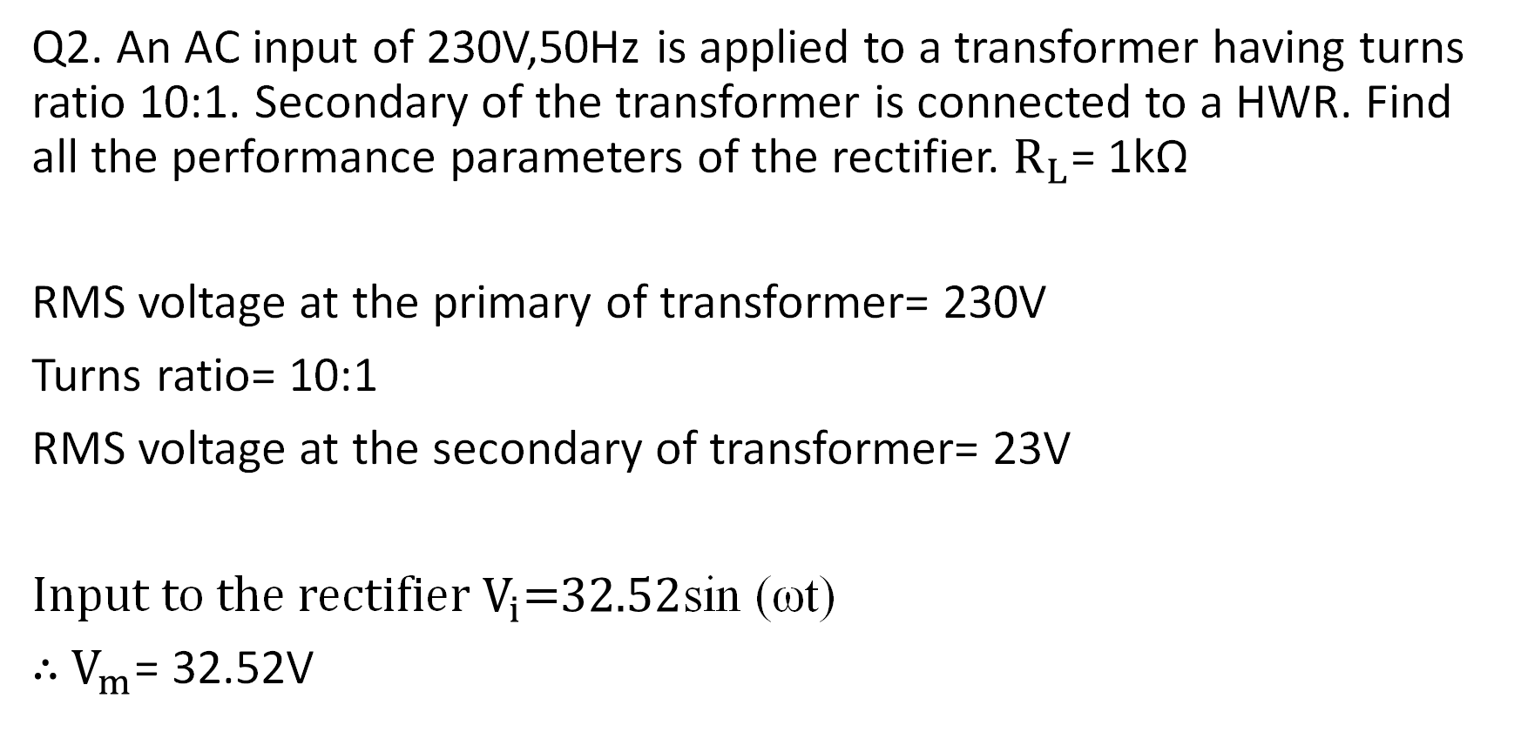
Q2. An AC input of 230V,50Hz is applied to a transformer having turns ratio 10:1. Secondary of the transformer is connected to a HWR. Find all the performance parameters of the rectifier. $R_{L}$= 1kΩ
RMS voltage at the primary of transformer= 230V
Turns ratio= 10:1
RMS voltage at the secondary of transformer= 23V
Input to the rectifier $V_{i}$=$32.52$sin (ωt)
$∴$ $V_{m}$= 32.52V

Slide 26
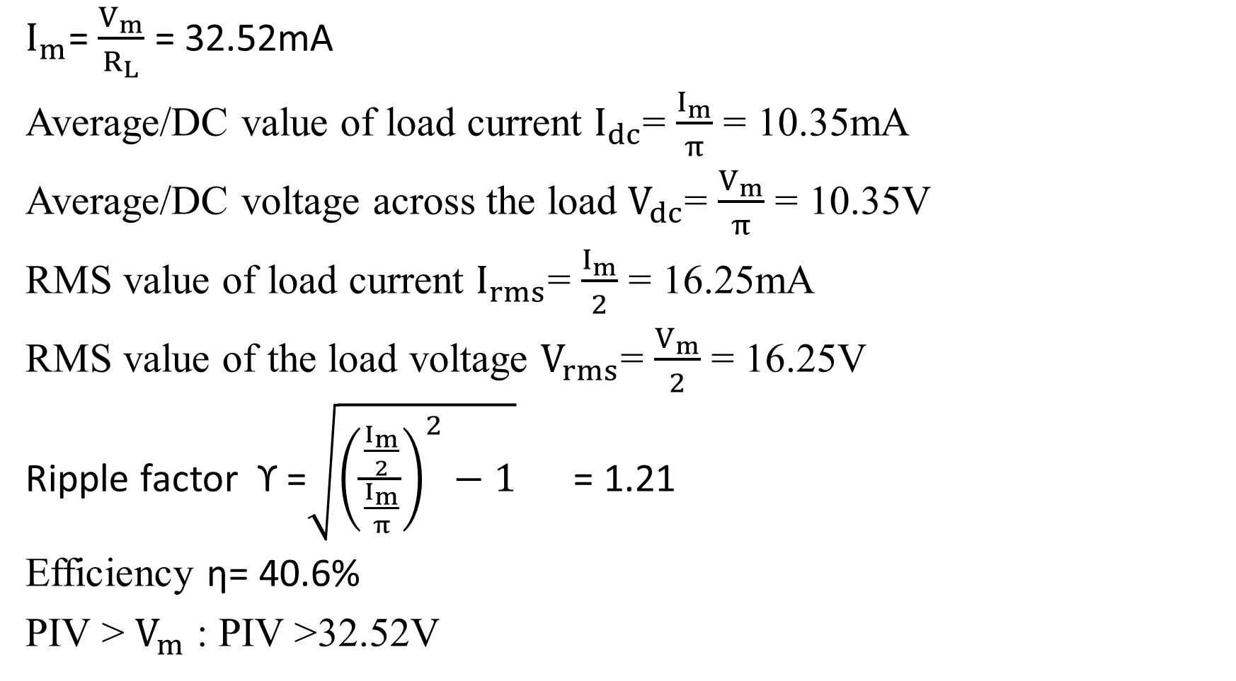
$I_{m}$= $\frac{V_{m}}{R_{L}}$ = 32.52mA
Average/DC value of load current $I_{dc}$= $\frac{I_{m}}{π}$ = 10.35mA
Average/DC voltage across the load $V_{dc}$= $\frac{V_{m}}{π}$ = 10.35V
RMS value of load current $I_{rms}$= $\frac{I_{m}}{2}$ = 16.25mA
RMS value of the load voltage $V_{rms}$= $\frac{V_{m}}{2}$ = 16.25V
Ripple factor ϒ =$\sqrt{{\left(\frac{\frac{I_{m}}{2}}{\frac{I_{m}}{π}}\right)}^{2}−1}$ = 1.21
Efficiency η= 40.6%
PIV > $V_{m}$ : PIV >32.52V

Slide 27
Q3. A sinusoidal voltage of peak value 10V is applied to a HWR. If the load resistance is 800Ω, calculate all the performance parameters of the rectifier.

Slide 28
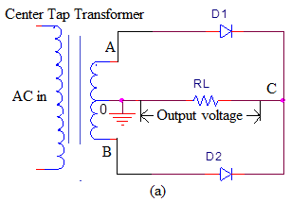
Full Wave Rectifier with centre tapped transformer

Slide 29
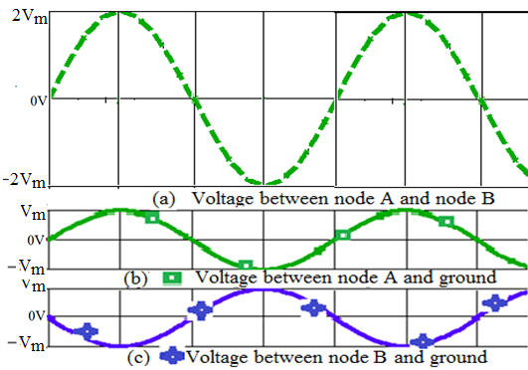
Full Wave Rectifier with centre tapped transformer

Slide 30
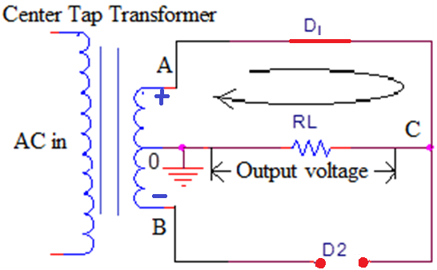
Working of Full Wave Bridge Rectifier
Center tapped FWR for node A is positive w.r.t B

Slide 31
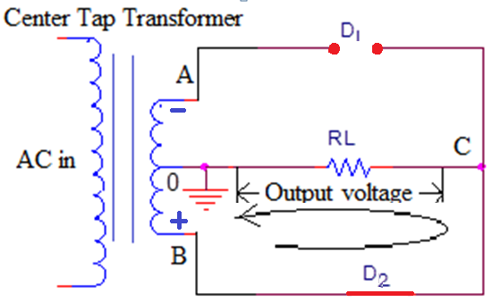
Working of Full Wave Bridge Rectifier
Center tapped FWR for node B is positive w.r.t A

Slide 32
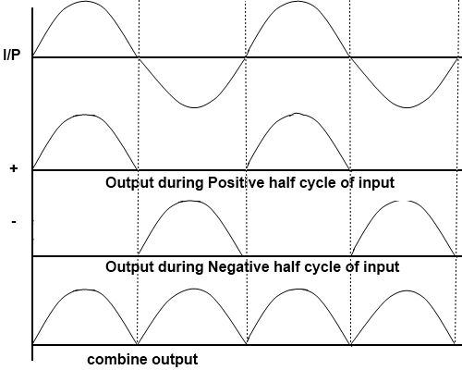
Note: Current through load during both cycles is in same direction (from node C to ground)
The frequency of the output signal =Twice the input frequency

Slide 33
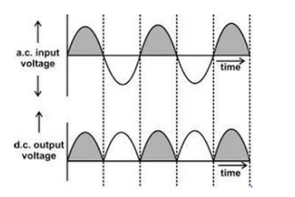

Performance parameters of FWR
$I$= $I_{m}$sin ($θ$) $, for 0≤θ≤π$
Where $I_{m}$ is the peak value of the input current
$I_{m}$=$\frac{V_{m}−V_{ϒ}}{R_{L}+R_{F}}$ = $\frac{V_{m}}{R_{L}}$ (Assume ideal diode with $V_{ϒ}$= 0 ; $R_{F}$=0)

Slide 34

Average/DC value of load current ($I_{dc}$)
$I_{dc}$=$\frac{1}{π}\int_{0}^{π}{I }$d($θ$)
= $\frac{1}{π}\int_{0}^{π}{I_{m}}$sin ($θ$)d($θ$)
= $\frac{I_{m}}{π}$ ${\left[−cos⁡(θ)\right]}_{0}^{π}$
$I_{dc}$= $\frac{{2I}_{m}}{π}$

Slide 35

Average/DC voltage across the load ($V_{dc}$)
$V_{dc}$= $I_{dc}$* $R_{L}$
= $\frac{{2I}_{m}}{π}$ * $R_{L}$
= $\frac{{2V}_{m}}{R_{L}∗π}$ * $R_{L}$
$V_{dc}$ = $\frac{{2V}_{m}}{π}$

Slide 36
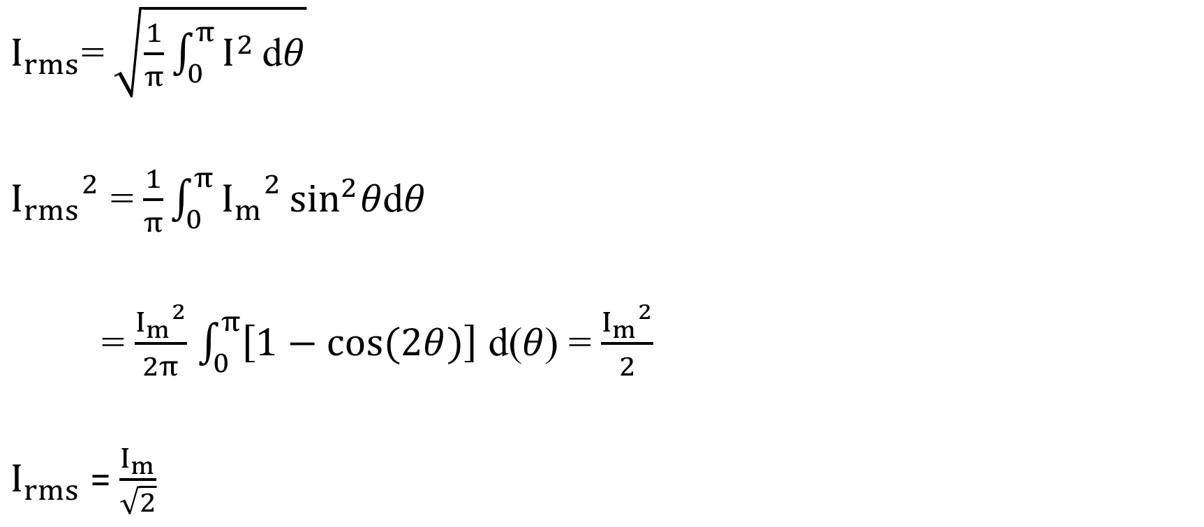
RMS value of load current ($I_{rms}$)
$I_{rms}$=$\sqrt{\frac{1}{π}\int_{0}^{π}{I^{2}}\text{d}θ}$
${I_{rms}}^{2}$ = $\frac{1}{π}\int_{0}^{π}{{I_{m}}^{2}}\sin^{2}θ\text{d}θ$
= $\frac{{I_{m}}^{2}}{2π}$ $\int_{0}^{π}{\left[1−cos(2θ)\right]}$ $\text{d}\text{(}θ\text{)}$ = $\frac{{I_{m}}^{2}}{2}$
$I_{rms}$ =$\frac{I_{m}}{\sqrt{2}}$

Slide 37

RMS value of the load voltage ($V_{rms}$)
$V_{rms}$= $I_{rms}$* $R_{L}$
=$\frac{I_{m}}{\sqrt{2}}$* $R_{L}$
= $\frac{V_{m}}{R_{L}∗\sqrt{2}}$ * $R_{L}$
$V_{rms}$ = $\frac{V_{m}}{\sqrt{2}}$

Slide 38
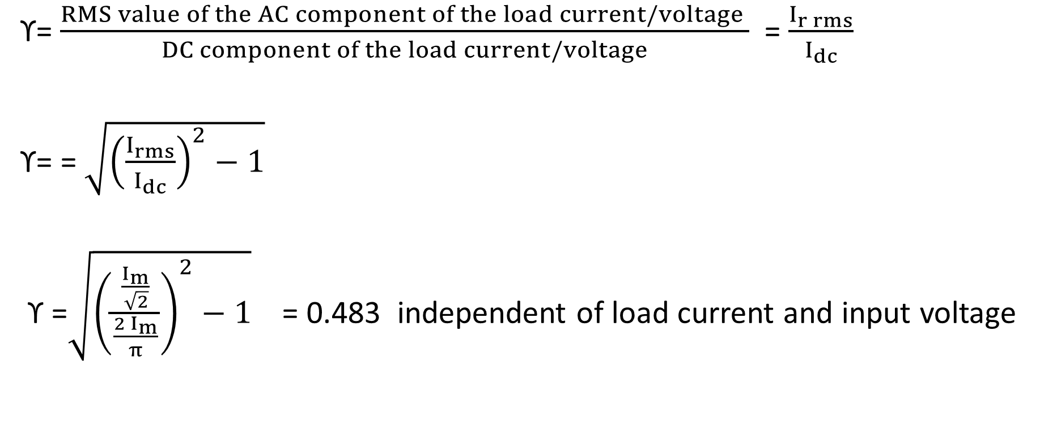
Ripple factor (ϒ)
ϒ= $\frac{RMS value of the AC component of the load current/voltage }{DC component of the load current/voltage}$ = $\frac{I_{r rms}}{I_{dc}}$
ϒ= = $\sqrt{{\left(\frac{I_{rms}}{I_{dc}}\right)}^{2}−1}$
ϒ =$\sqrt{{\left(\frac{\frac{I_{m}}{\sqrt{2}}}{\frac{{2 I}_{m}}{π}}\right)}^{2}−1}$ = 0.483 independent of load current and input voltage

Slide 39
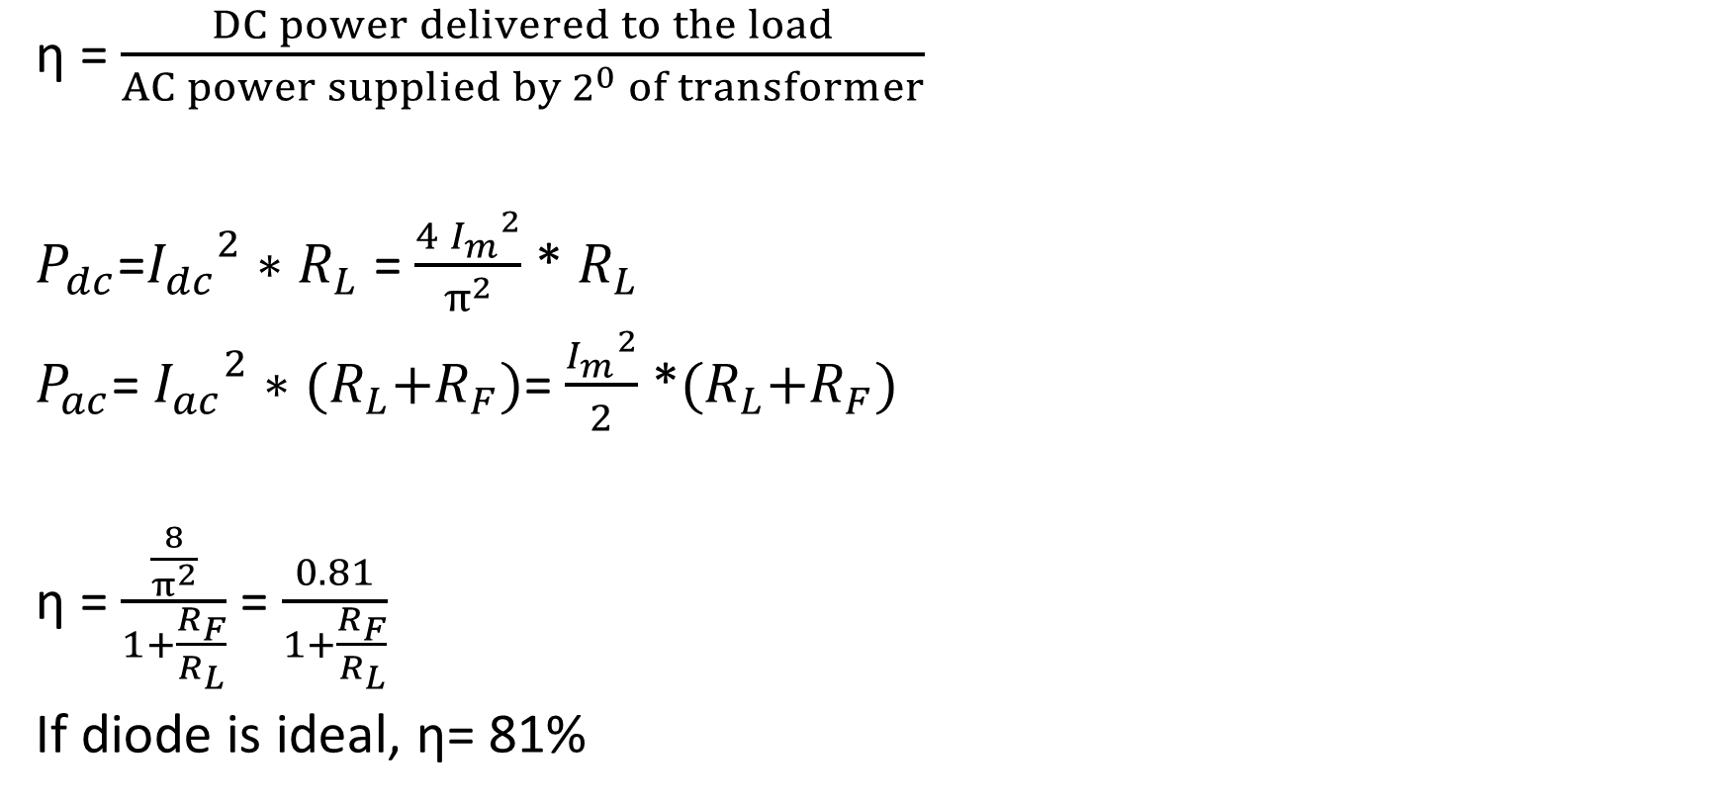
Efficiency (η)
η = $\frac{DC power delivered to the load}{AC power supplied by 2^{0} of transformer}$
$P_{dc}$=${I_{dc}}^{2}∗$ $R_{L}$ = $\frac{{{4 I}_{m}}^{2}}{π^{2}}$ * $R_{L}$
$P_{ac}$= ${I_{ac}}^{2}∗$ ${(R}_{L}+R_{F})$= $\frac{{I_{m}}^{2}}{2}$ *${(R}_{L}+R_{F})$
η = $\frac{\frac{8}{π^{2}}}{1+\frac{R_{F}}{R_{L}}}$ = $\frac{0.81}{1+\frac{R_{F}}{R_{L}}}$
If diode is ideal, η= 81%

Slide 40
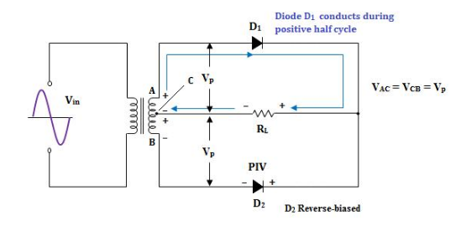

Peak Inverse Voltage(PIV)
Maximum voltage across the diode when it is reverse biased
Choose a diode with PIV> $2V_{m}$

Slide 41
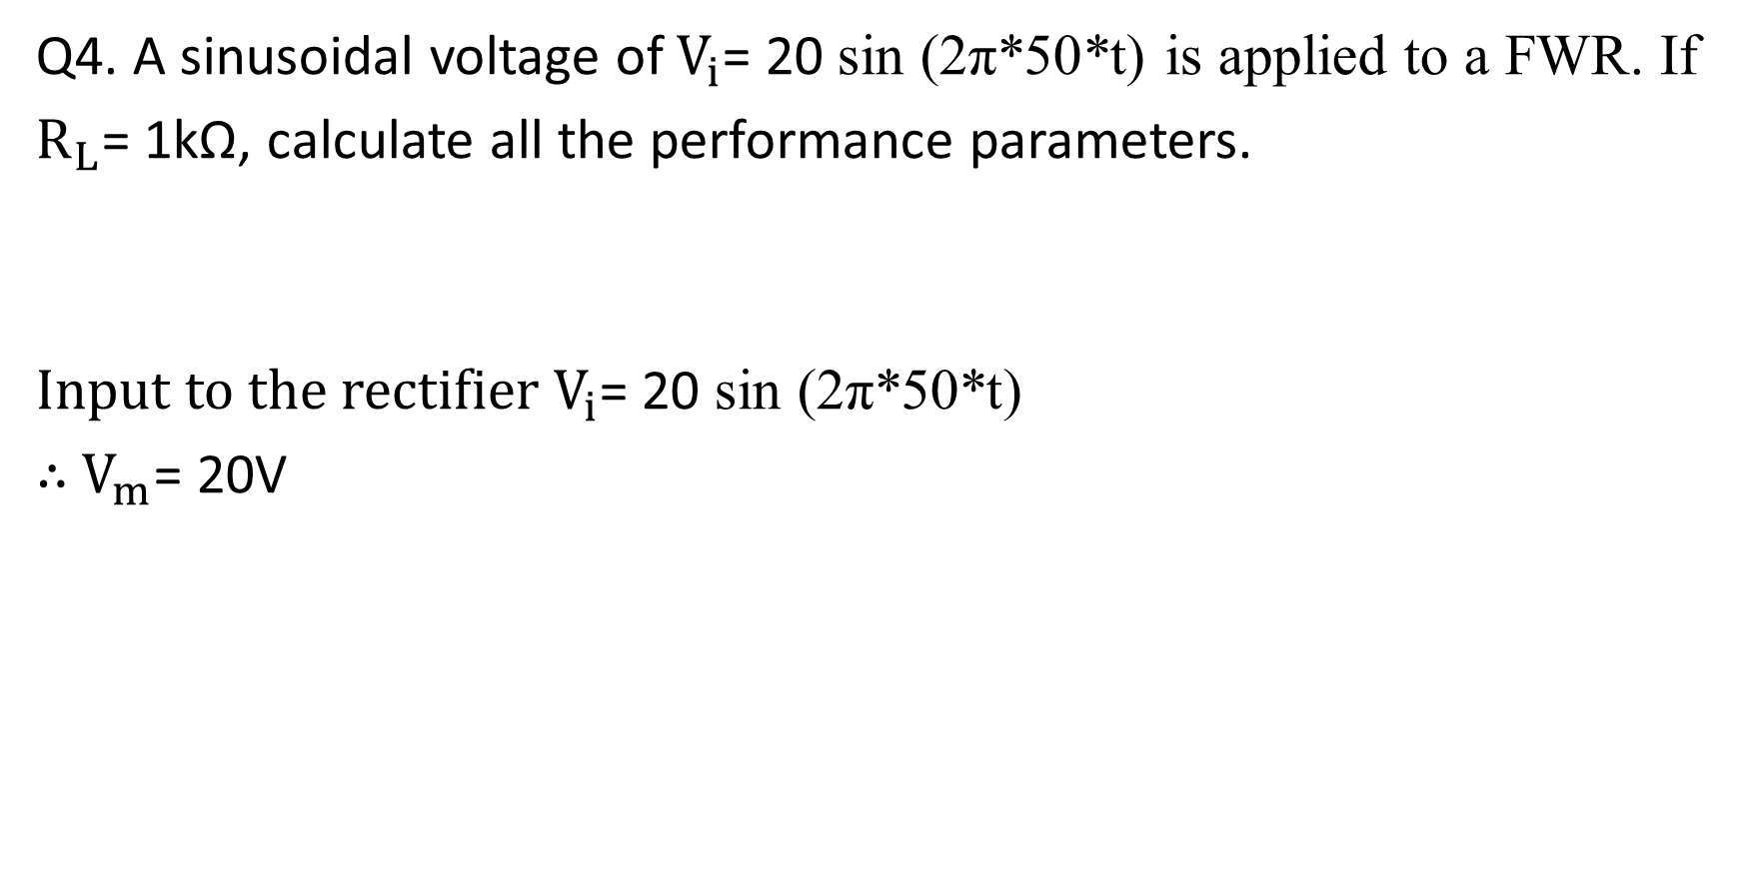
Q4. A sinusoidal voltage of $V_{i}$= 20 sin (2π*50*t) is applied to a FWR. If
$R_{L}$= 1kΩ, calculate all the performance parameters.
Input to the rectifier $V_{i}$= 20 sin (2π*50*t)
$∴$ $V_{m}$= 20V

Slide 42
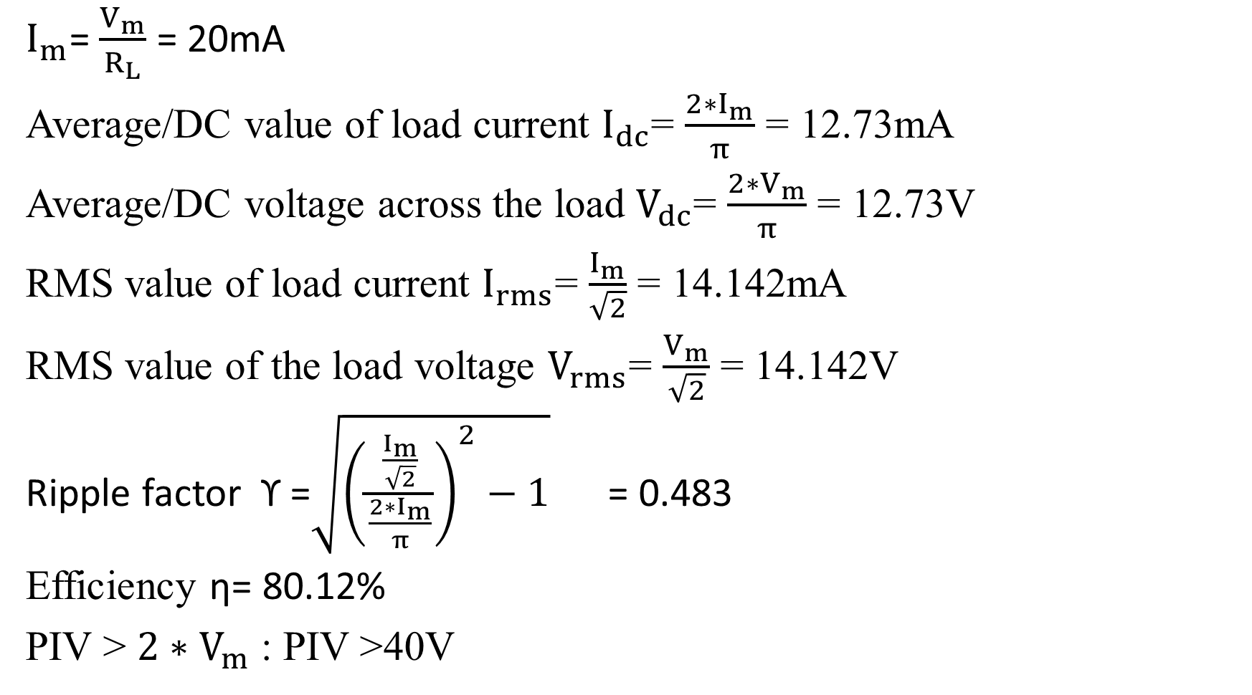
$I_{m}$= $\frac{V_{m}}{R_{L}}$ = 20mA
Average/DC value of load current $I_{dc}$= $\frac{2∗I_{m}}{π}$ = 12.73mA
Average/DC voltage across the load $V_{dc}$= $\frac{2∗V_{m}}{π}$ = 12.73V
RMS value of load current $I_{rms}$= $\frac{I_{m}}{\sqrt{2}}$ = 14.142mA
RMS value of the load voltage $V_{rms}$= $\frac{V_{m}}{\sqrt{2}}$ = 14.142V
Ripple factor ϒ =$\sqrt{{\left(\frac{\frac{I_{m}}{\sqrt{2}}}{\frac{2∗I_{m}}{π}}\right)}^{2}−1}$ = 0.483
Efficiency η= 80.12%
PIV > $2∗V_{m}$ : PIV >40V

Slide 43

Q4. A center-tapped FWR is supplied with 230V, 50 Hz AC mains through a step down transformer with turns ratio equal to 10. If $R_{L}$= 1kΩ, find the average and RMS value of the load current, PIV rating of the diode used for proper working.
Ans: Vm=16.26V, Im=16.26mA, Iav=10.35mA, Irms =11.49mA, PIV>32.52V

Slide 44
Q5. A sinusoidal voltage with 20-0-20 V applied to secondary of the transformer used for full wave rectification. If the load resistance is 1000Ω, calculate : (a) Peak value of load current (b) Average load current (c) Rms load current (d) Average output voltage (e) Rms output voltage (f) Efficiency (g) Ripple factor
Ans: Vm=28.28V, Im=27.4mA, Idc=17.44mA, Irms=19.3mA, Vrms=19.37V, Vdc=17.44V, Eff=80%, Ripple factor=0.483

Slide 45

Bridge Rectifier
Fig.17(a) : Bridge FWR

Slide 46

Working of Bridge FWR
Bridge FWR when node A is positive w.r.t B
Notes:
For the first half of the time period, during which node A is positive with respect to B, D1 and D2 are forward biased whereas D3 and D4 are reverse biased. As said earlier considering ideal diodes D1, D2 are shorted and D3,D4 are open as in fig 18. This results in a current flow taking a closed path from node A, through D1, R-Load, D2 and from node B through the secondary coil as indicated. Note that current through the load resistor flows from node C to ground.
Similarly for the second half of the time period, during which node B is positive with respect to A, D3 and D4 are forward biased whereas D1 and D2 are reverse biased. Diodes D3, D4 are shorted and D1,D2 are open as shown in figure 19. This results in a current flow taking a closed path from node B, through D4, R-Load, D3 and from node A through the secondary coil as indicated. Note that again current through the load resistor flows from node C to ground even though the current through the secondary has reversed.
Thus output voltage is unidirectional for both the half cycle

Slide 47

Working of Bridge FWR
Bridge FWR when node B is positive w.r.t. A
Note: Current through load for both cycles is in same direction
(from node C to ground)

Slide 48

Bridge FWR
Fig. 20 : Input and output waveforms of bridge rectifier
Note: The frequency of the output signal =2 times the input frequency

Slide 49
Bridge FWR
PIV : V_{m} , where V_{m} peak of secondary voltage (between node A and node B).
Other parameters same as Center tapped FWR:
Ripple factor is:
Efficiency:

Slide 50
Comparison of Rectifiers
Parameters of rectified signal | HWR | Center-tapped FWR | Bridge FWR
V_{dc}
V_{RMS}
PIV
Ripple factor
Efficiency
Frequency f_{o}
1.21 0.483 0.483
40.6% 81.2% 81.2%

Slide 51
Comparison of Rectifiers
Advantages of HWR over FWR
Advantages of Center tapped FWR rectifier over HWR
Advantages of bridge rectifier over to centre-tap FWR
Disadvantages of HWR over FWR
Disadvantages of centre-tap FWR over Bridge
Disadvantages of bridge rectifier over other rectifiers
Notes:
Advantages of HWR over FWR
Simple circuit
Single diode
PIV rating is V_{m}
Advantages of Center tapped FWR rectifier over HWR
High Efficiency
low ripple factor
Advantages of bridge rectifier over to centre-tap FWR
PIV rating is Vm
Does not use Centre-tap transformer
Disadvantages of HWR over FWR
High ripple factor
Low efficiency
Disadvantages of centre-tap FWR over Bridge
Uses center tapped transformer
Disadvantages of bridge rectifier over other rectifiers
Four diodes are used

Slide 52
Capacitor Filter
Commonly referred as C type filter
Key component of filter is the energy storing elements. Example: Capacitor
Capacitor allows AC component and blocks DC component
Capacitor helps to hold the output voltage to its maximum or peak value.
It can be used with HWR as well as with FWR

Slide 53

Capacitor Filter
C type filter with HWR
Notes:
The property of a capacitor is that, it allows ac component and blocks dc component. The operation of the capacitor filter is to minimize the ripple and to increase the dc voltage.

Slide 54

Capacitor Filter
Fig: C type filter with Bridge FWR

Slide 55

Capacitor Filter
Fig. 23 Filtered output waveform using C type filter
Notes:
The capacitor charges to its peak value through Diode and secondary. But as the voltage starts reducing from peak value the Capacitor tries to retain the voltage to the peak. But the capacitor will discharge through the load resistance slowly until the transformer secondary voltage again increases to a value greater than the capacitor voltage.

Slide 56
Ripple factor with Capacitor Filter
For HWR
For FWR

Slide 57
Ripple factor with Capacitor Filter
DC value of filtered output for HWR
DC value of filtered output for FWR
Note: here f is the frequency of the input signal

Slide 58
Comparison of Rectifiers
Parameters of rectified signal | HWR | FWR
V_{dc}
Ripple factor

Slide 59
Numerical Problems
1. Primary voltage is 120V, 60Hz. Turns ratio is 5:1. This transformer supplies to bridge rectifier employing 4 identical ideal diodes. The load resistance is 1kΩ. Calculate average and rms load voltage, efficiency, ripple factor, PIV rating and frequency of output waveform.
Ans: Vm=33.9V, Im=33.9mA, PIV>33.9V Vdc=21.58V, Vrms= 24V

Slide 60

2. A half wave rectifier with capacitor filter is supplied from transformer having peak secondary voltage 20V and freq 50Hz. The load resistance is 560Ω and capacitor used is 1000μF. Calculate ripple factor and dc output voltage. Draw the filtered output and label peak and dc value.
(Ans:0.0103, 19.65V)

Slide 61
3. A full wave rectifier with capacitor filter has to supply an average voltage of 30V to 900Ω load. Calculate the rms input voltage and value of capacitor such that the ripple factor does not exceed 0.05, assuming f = 50Hz.
Ans: C>64.15microF, Vm=32.59V, Vrms=23V

Slide 62
4. (a) A half wave rectifier is fed from a transformer having turns ratio 6:1.The primary voltage is 110V at 60Hz. It is decided to have ripple factor of 0.03 and dc load current of 500mA. Find the value of capacitor needed. (b) Repeat for full wave bridge rectifier
Ans: C=3.25mF

Slide 63
5. A load is to be supplied 10mA current at 5V dc, with ripple not more than 0.2%. Calculate the value of capacitor needed for the full wave bridge rectifier. Also, if the primary voltage of transformer is 220V at 50Hz, calculate the turns ratio needed.
(Ans: 2.89mF, 62)

Slide 64
Summary
Discuss block diagram of a basic DC power supply unit.
Explain and analyze the working of various rectifier circuits.
Evaluate Output DC value, ripple factor, efficiency and PIV, of different rectifier circuits.
Explain the working of rectifier circuits with capacitor filter

